Slide 1
Data Mining DS-303
Lecture 3
Muhammad Arham
Lecturer
The University of Faisalabad

Slide 2
Content
Data Pre-Processing Techniques

Slide 3
Data Pre-Processing

Slide 4

Data Pre-processing
It is a data mining technique that involves transforming raw data into an understandable format.

Slide 5
Why Pre-Process the Data?

Slide 6
Data Preprocessing
Data in the real world is:
Incomplete: lacking values, certain attributes of certain attributes of interest, etc.
Noisy: containing errors or outliers
Inconsistent: lack of compatibility or similarity between two or more facts.
No quality data, no quality mining results!
Quality decisions must be based on quality data.
Data warehouse needs consistent integration of quality data.

Slide 7
Measure of Data Quality
Accuracy
Completeness
Consistency
Timeliness
Believability
Value added
Interpretability
Accessibility

Slide 8
Data Pre-Process Techniques

Slide 9
Data pre-processing techniques
Data Cleaning
Data Integration
Data Transformation
Data Reduction

Slide 10
Major Tasks in Data Preprocessing
Data Cleaning
Fill in missing values, smooth noisy data, identify or remove outliers, and resolve inconsistencies.
Data Integration
Integration of multiple databases, data cubes, or files
Data Transformation
Normalization and aggregation
Data Reduction
Obtains reduced representation in volume but produces the same or similar analytical results

Slide 11
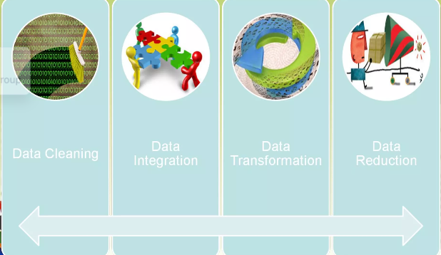
Data Pre-Processing

Slide 12
Data Cleaning

Slide 13

Data Cleaning
Data Cleaning attempt to fill in missing values, smooth out noise while identifying outliers, and correct inconsistencies in the real-world data.

Slide 14
Data Cleaning – Missing values
Ignore the tuple
Fill in the missing value manually
Use a global constant
Use attribute mean
Use the most probable value
(Decision tree, Bayesian formalism)

Slide 15
Data Cleaning – Noisy data
Binning
Clustering
Combined computer and human inspection
Regression

Slide 16
Data Cleaning – Inconsistent Data
Manually using external references
Knowledge engineering tools

Slide 17
Data Integration

Slide 18
Data Integration
Data integration implies combining of data from multiple sources into a coherent data store (data warehouse).

Slide 19
Data Integration – Issues
Entity identification problem
Redundancy
Tuple duplication
Detecting data values conflicts

Slide 20
Data Transformation

Slide 21
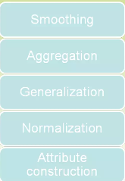
Data Transformation
Transforming or consolidating data into mining suitable form is known as data transformation.

Slide 22
Handling Redundant Data in Data Integration
Redundant data occurs often when integration of multiple databases.
The same attributes may have different names in different databases.
One attribute may be a derived attribute in another table, e.g., annual revenue.

Slide 23
Handling Redundant Data in Data Integration
Redundant data may be able to be detected by correlation analysis
Careful integration of the data from multiple sources may help reduce/avoid redundancies and inconsistencies and improve mining speed and quality.

Slide 24
Data Transforming
Smoothing: remove noise from data
Aggregation: summarization, data cube construction
Generalization: concept hierarchy climbing

Slide 25
Data Reduction

Slide 26
Data Reduction
Data reduction techniques are applied to obtain a reduced representation of the data set that is much smaller in volume, yet closely maintains the integrity of base data.

Slide 27
Data Reduction – Strategies
Data cube aggregation
Dimension Reduction
Data Compression
Numerosity Reduction
Discretization and concept hierarchy generation

Slide 28
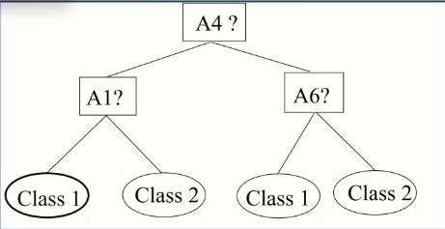
Example of Decision Tree Induction
Initial attributes set:
{A1, A2, A3, A4, A5, A6}
Reduced attributes set: {A1, A4, A6}

Slide 29
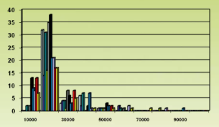
Histogram
A popular data reduction technique.
Divide data into buckets and store average (sum) for each bucket.
Can be constructed optimally in one dimension.
Related to quantization problem.

Slide 30
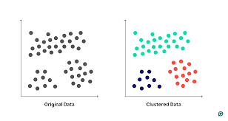
Clustering
Partition data set into clusters, and one can store cluster representation only
Can be very effective if data is clustered.
Can have hierarchical clustering and be stored in a multi-dimensional index tree structure.

Slide 31
Sampling
Allows a large data set to be represented by a much smaller of the data.
Let a large data set D, contain N tuples.
Methods to reduce data set D:
Simple random sample without replacement (SRSWOR)
Simple random sample with replacement (SRSWR)
Cluster sample
Straight sample

Slide 32
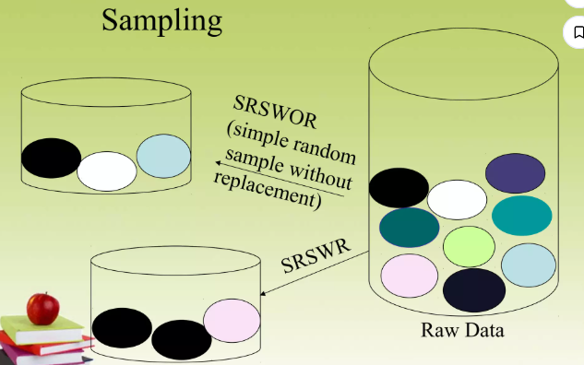
Sampling

Slide 33
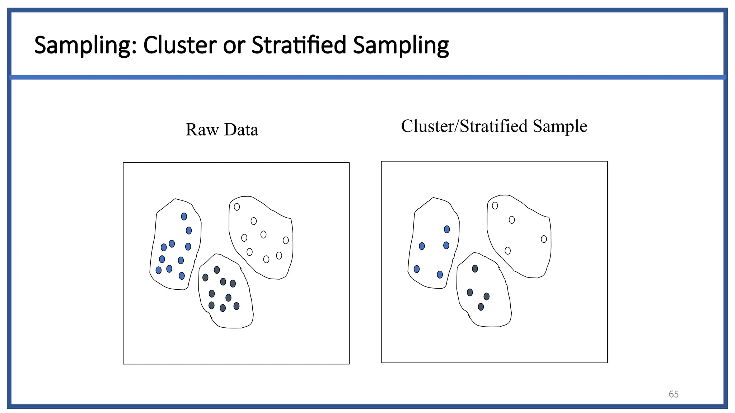
Sampling

Slide 34
Reference
https://www.slideshare.net/slideshow/data-preprocessing-31623210/31623210
https://www.slideshare.net/slideshow/data-preprocessing-in-data-mining-188113092/188113092

Slide 35
Advice
Kindly read the book before and after the lecture, if some terms/ words are not covered in the lecture, if appear in exam it might not appear strange or out of course.

